Slide 1

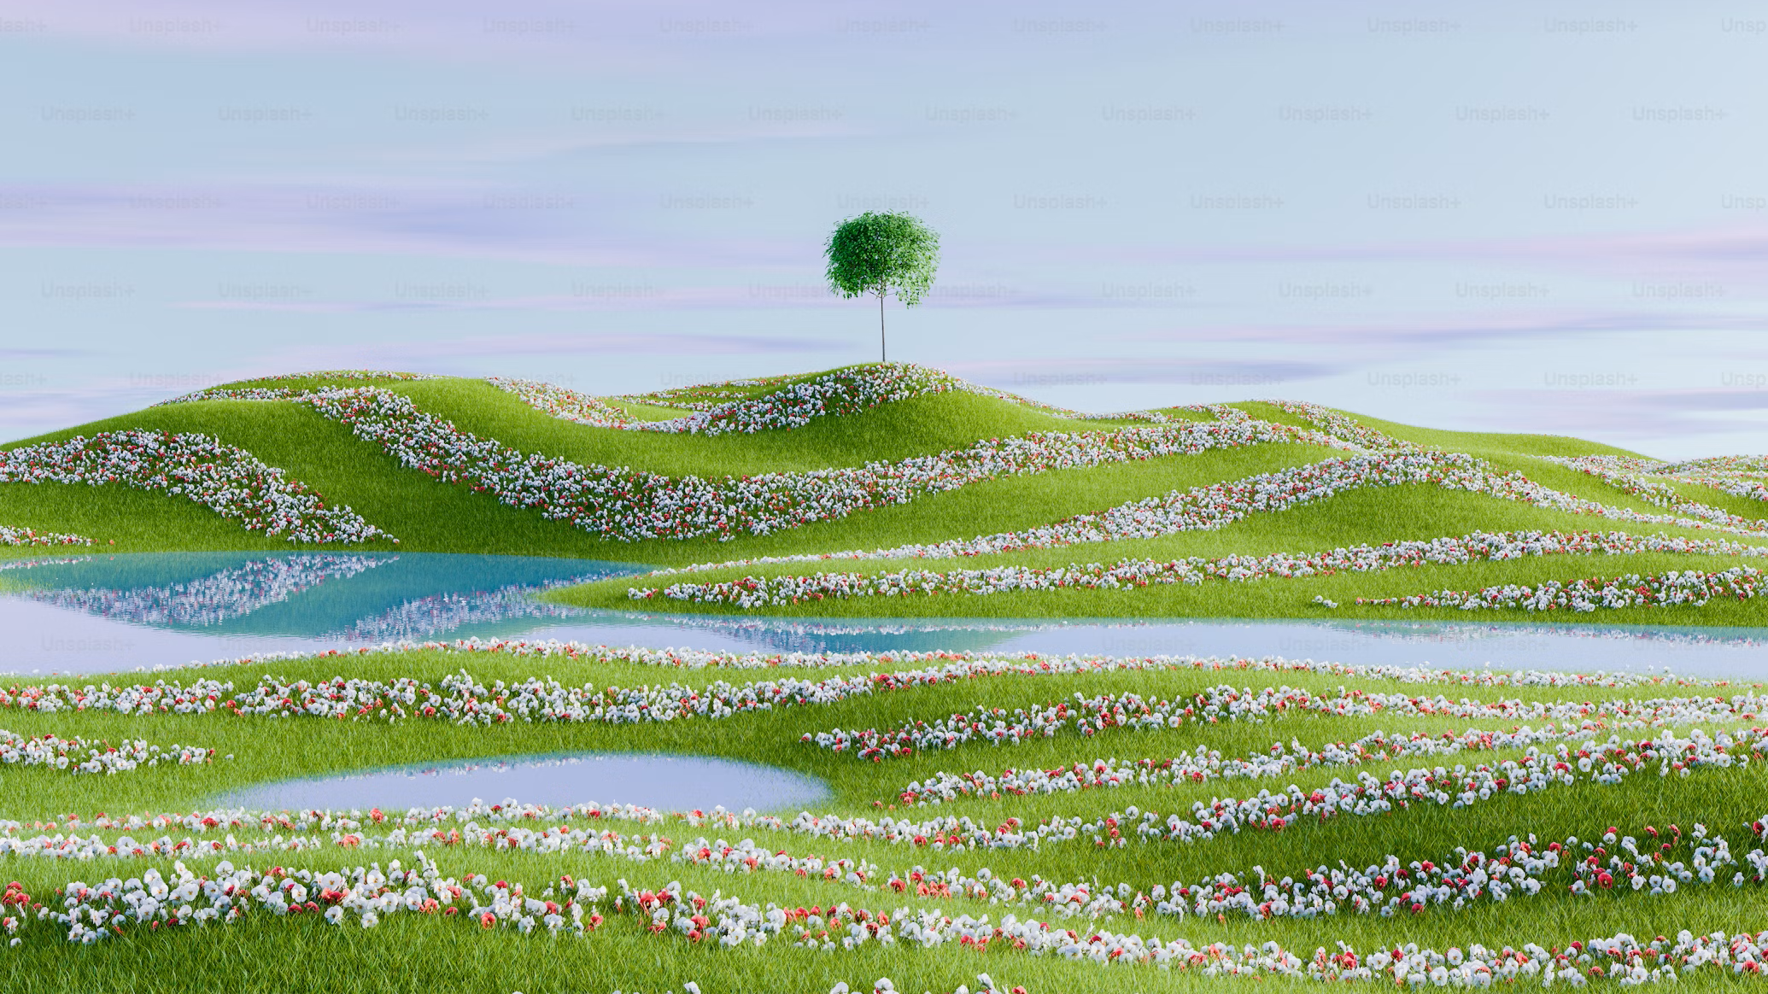
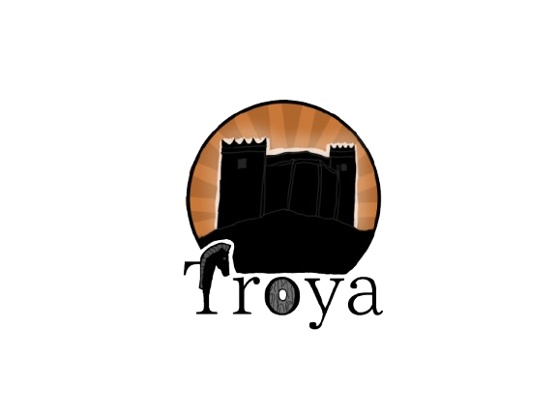
Troya
Technologies
Game
Project
Realization
Team

Slide 2

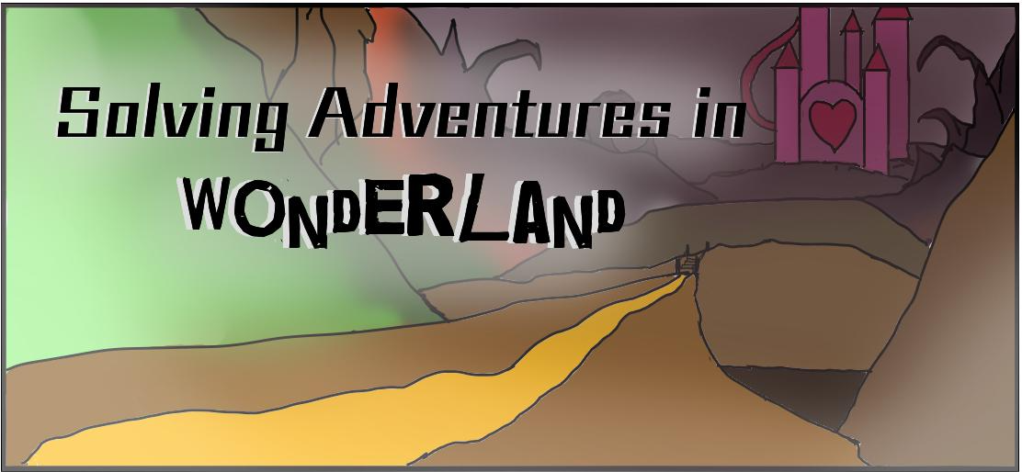
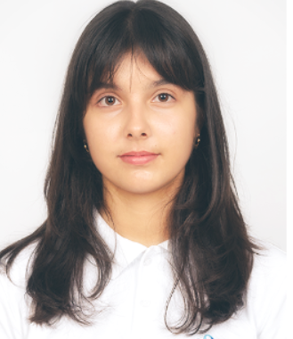
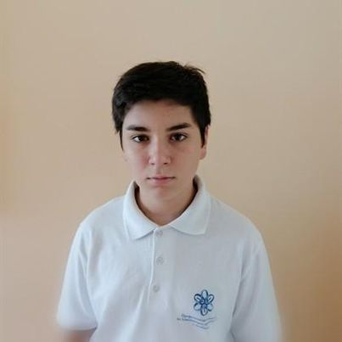


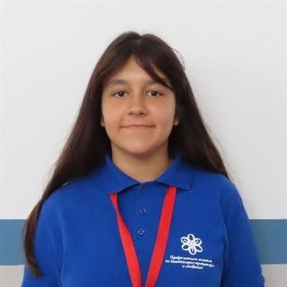
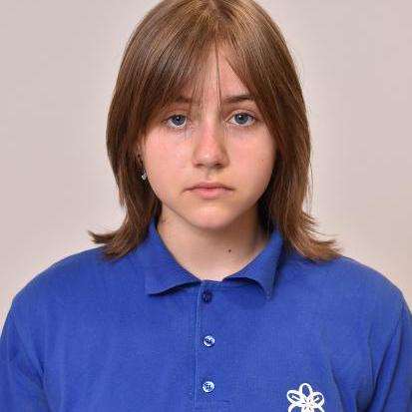



Let’s see our game!
Team
Realization
Project
Game
Technologies
Stage 1
Stage 2
Stage 3
Alice’s Solving Adventures is designed to be a dynamic and engaging educational game that blends the challenges of math and language in a fun and interactive format. With its well-balanced levels combining math equations and word games, the game not only tests the players' skills but also encourages critical thinking and problem-solving. With its systematic development and focus on educational value, Alice’s Solving Adventures is well-positioned to offer a meaningful and enjoyable learning experience that aligns with its core goals of fostering skills and encouraging intellectual growth.
GitHub
1st week
For storage and collaboration
3rd week
2nd week
Ulvie Mustafa
Martin Dimarov
Make documentation
Make read me
Make presentation
Develope an Idea
Create working enviroment
Make team logo
Make game logo
Make menu
Design for level 1
Level 1 developement
Design for level 2
Level 2 developement
Design for level 3
Level 3 developement
Design for level 4
Level 4 developement
Scrum Trainer
Front-End Developer
Game developement
Sheniz Ali
Ameliia Dorosh
Visual Studio 2022
PowePoint
Back-End Developer
For presentation
Designer
Build code
C++
Discord
Word
For comunication
For documentation

Slide 3
Realization
Project
Team
Ulvie Mustafa
Martin Dimarov
Scrum Trainer
Front-End Developer
Game
Technologies
Sheniz Ali
Ameliia Dorosh
Back-End Developer
Designer

Slide 4
Realization
Project
Team
Ulvie Mustafa
Martin Dimarov
Scrum Trainer
Front-End Developer
Sheniz Ali
Ameliia Dorosh
Back-End Developer
Designer
Game
Technologies

Slide 5
Project
Team
Realization
Game
Ulvie Mustafa
Martin Dimarov
Scrum Trainer
Front-End Developer
Stage 1
Stage 2
Stage 3
1st week
2nd week
3rd week
Technologies
Make documentation
Make read me
Make presentation
Develope an Idea
Create working enviroment
Make team logo
Make game logo
Make menu
Design for level 1
Level 1 developement
Design for level 2
Level 2 developement
Design for level 3
Level 3 developement
Design for level 4
Level 4 developement
Sheniz Ali
Ameliia Dorosh
Back-End Developer
Designer

Slide 6
Project
Team
Realization
Stage 1
Stage 2
Stage 3
1st week
2nd week
3rd week
Make documentation
Make read me
Make presentation
Develop an Idea
Create working enviroment
Make team logo
Make game logo
Make menu
Design for level 1
Level 1 development
Design for level 2
Level 2 development
Design for level 3
Level 3 development
Design for level 4
Level 4 development
Game
Technologies

Slide 7
Realization
Team
Project
Game
Stage 1
Stage 2
Stage 3
Technologies
Alice’s Solving Adventures is designed to be a dynamic and engaging educational game that blends the challenges of math and language in a fun and interactive format. With its well-balanced levels combining math equations and word games, the game not only tests the players' skills but also encourages critical thinking and problem-solving. With its systematic development and focus on educational value, Alice’s Solving Adventures is well-positioned to offer a meaningful and enjoyable learning experience that aligns with its core goals of fostering skills and encouraging intellectual growth.
1st week
2nd week
3rd week
Alice’s Solving Adventures is designed to be a dynamic and engaging educational game that blends the challenges of math and language in a fun and interactive format. With its well-balanced levels combining math equations and word games, the game not only tests the players' skills but also encourages critical thinking and problem-solving. With its systematic development and focus on educational value, Alice’s Solving Adventures is well-positioned to offer a meaningful and enjoyable learning experience that aligns with its core goals of fostering skills and encouraging intellectual growth.
Make documentation
Make read me
Make presentation
Develope an Idea
Create working enviroment
Make team logo
Make game logo
Make menu
Design for level 1
Level 1 developement
Design for level 2
Level 2 developement
Design for level 3
Level 3 developement
Design for level 4
Level 4 developement

Slide 8
Realization
Team
Project
Game
Solving Adventures in wonderland is designed to be a dynamic and engaging educational game that blends the challenges of math and language in a fun and interactive format. With its well-balanced levels combining math equations and word games, the game not only tests the players' skills but also encourages critical thinking and problem-solving. With its systematic development and focus on educational value, Alice’s Solving Adventures is well-positioned to offer a meaningful and enjoyable learning experience that aligns with its core goals of fostering skills and encouraging intellectual growth.
Technologies

Slide 9

Realization
Project
Team
Technologies
Alice’s Solving Adventures is designed to be a dynamic and engaging educational game that blends the challenges of math and language in a fun and interactive format. With its well-balanced levels combining math equations and word games, the game not only tests the players' skills but also encourages critical thinking and problem-solving. With its systematic development and focus on educational value, Alice’s Solving Adventures is well-positioned to offer a meaningful and enjoyable learning experience that aligns with its core goals of fostering skills and encouraging intellectual growth.
Game
GitHub
For storage and collaboration
Medibang paint
Game developement
For the creation of the design and logo
Visual Studio 2022
PowePoint
Build code
For presentation
C++
Discord
Word
For comunication
For documentation

Slide 10
Realization
Project
Team
Technologies
Discord
Word
For comunication
For documentation
Visual Studio 2022
PowerPoint
Build code
For presentation
Medibang paint
C++
For the creation of the design and logo
Game developement
GitHub
For storage and collaboration
Game

Slide 11
Team
Realization
Project
Game
Technologies
Let’s see our game!

Slide 12
Team
Realization
Project
Let’s see our game!
Game
Technologies

